Slide 1

2-1
Integers
Warm Up
Problem of the Day
Lesson Presentation
Course 2

Slide 2
Warm Up
Compare. Use <, >, or =
1. 7 5
2. 32 65
3. 82 28
4. 64 48
>
<
>
>

Slide 3
Learn to compare and order integers and to determine absolute value.

Slide 4
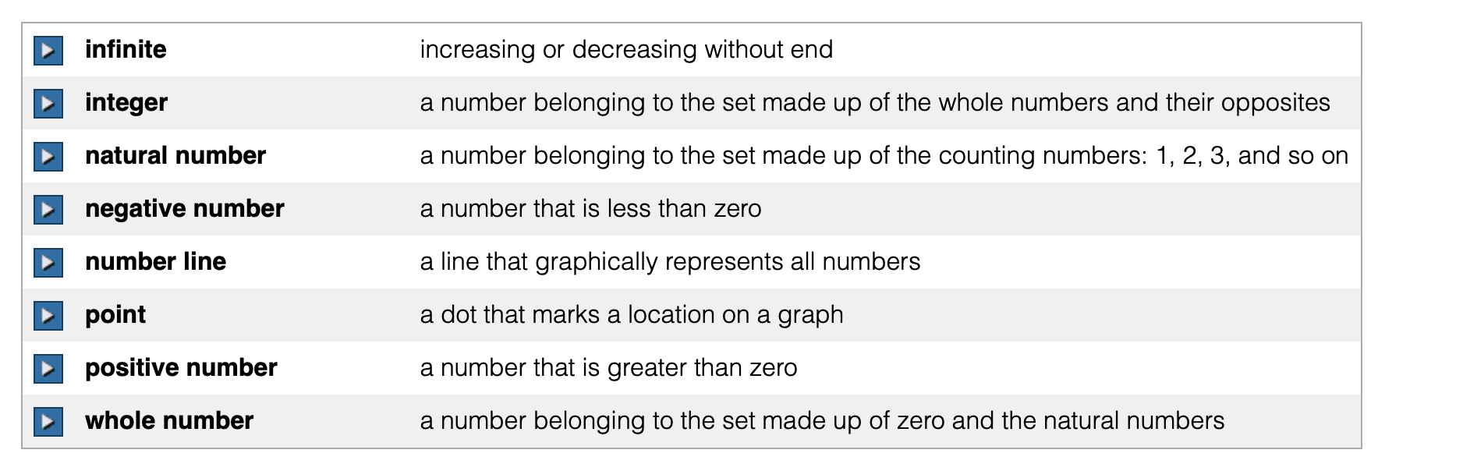
Vocabulary

Slide 5
The opposite of a number is the same
distance from 0 on a number line as the
original number, but on the other side
of 0. Zero is its own opposite.
–4 and 4 are opposites
–4
4
•
•
–5–4–3–2–1 0
1 2 3 4 5
Negative integers
Positive integers
0 is neither positive
nor negative

Slide 6
The integers are the set of whole numbers and their opposites. By using integers, you can express elevations above, below, and at sea level. Sea level has an elevation of 0 feet.
Remember!
The whole numbers are the counting numbers and zero: 0, 1, 2, 3, . . . .

Slide 7
Additional Example 1: Graphing Integers and Their Opposites on a Number Line
Graph the integer −7 and its opposite on a number line.
7 units 7 units
–7–6–5–4–3–2–1 0
1 2 3 4 5 6 7
The opposite of –7 is 7.

Slide 8
Check It Out: Example 1
Graph the integer −5 and its opposite on a number line.
5 units 5 units
–7–6–5–4–3–2–1 0
1 2 3 4 5 6 7
The opposite of –5 is 5.

Slide 9
You can compare and order integers by graphing them on a number line. Integers increase in value as you move to the right along a number line. They decrease in value as you move to the left.

Slide 10
Additional Example 2A: Comparing Integers Using a Number Line
Compare the integers. Use < or >.
4 -4
>
–7–6–5–4–3–2–1 0
1 2 3 4 5 6 7
4 is farther to the right than -4, so 4 > -4.
Remember!
The symbol < means “is less than,” and the symbol > means “is greater than.”

Slide 11
Additional Example 2B: Comparing Integers Using a Number Line
Compare the integers. Use < or >.
-15 -9
>
-15 -14 -13 -12 -11 -10 -9 -8 -7 -6 -5 -4 -3 -2 -1
-9 is farther to the right than -15, so -15 < -9.

Slide 12
Check It Out: Example 2A
Compare the integers. Use < or >.
6 -6
>
–7–6–5–4–3–2–1 0
1 2 3 4 5 6 7
6 is farther to the right than -6, so 6 > -6.

Slide 13
Check It Out: Example 2B
Compare the integers. Use < or >.
>
-4 -11
-15 -14 -13 -12 -11 -10 -9 -8 -7 -6 -5 -4 -3 -2 -1
-4 is farther to the right than -11, so -4 > -11.

Slide 14
Additional Example 3: Ordering Integers Using a Number Line.
Use a number line to order the integers from least to greatest.
–3, 6, –5, 2, 0, –8
–8 –7–6 –5–4 –3 –2 –1 0
1 2 3 4 5 6 7 8
The numbers in order from least to greatest are –8, –5, –3, 0, 2, and 6.

Slide 15
Check It Out: Example 3
Use a number line to order the integers from least to greatest.
–5, 4, –3, 2, –1, –2
–8 –7–6–5–4 –3–2 –1 0
1 2 3 4 5 6 7 8
The numbers in order from least to greatest are –5, –3, –2, –1, 2, and 4.

Slide 16
A number’s absolute value is its distance from 0 on a number line. Since distance can never be negative, absolute values are never negative. They are always positive or zero.

Slide 17
Additional Example 4A: Finding Absolute Value
Use a number line to find each absolute value.
|8|
8 units
–8 –7–6–5–4 –3–2 –1 0
1 2 3 4 5 6 7 8
8 is 8 units from 0, so |8| = 8.

Slide 18
Reading Math
The symbol is read as “the absolute value of.” For example -3 is the absolute value of -3.

Slide 19
Additional Example 4B: Finding Absolute Value
Use a number line to find each absolute value.
|–12|
12 units
–12 –11 –10 –9 –8 –7 –6 –5 –4 –3 –2 –1 0 1 2
–12 is 12 units from 0, so |–12| = 12.

Slide 20
Check It Out: Example 4A
Use a number line to find each absolute value.
|3|
3 units
–8 –7–6–5–4 –3–2 –1 0
1 2 3 4 5 6 7 8
3 is 3 units from 0, so |3| = 3.

Slide 21
Check It Out: Example 4B
Use a number line to find the absolute value.
|–9|
9 units
–12 –11 –10 –9 –8 –7 –6 –5 –4 –3 –2 –1 0 1 2
–9 is 9 units from 0, so |–9| = 9.

Slide 22
Lesson Quiz: Part I
Compare. Use <, >, or =.
1. –32 32
2. 26 |–26|
3. –8 –12
4. Use a number line to order the integers –2, 3, –4, 5, and –1 from least to greatest.
<
=
>
•
•
•
•
•
–4, –2, –1, 3, 5
–5–4 –3 –2–1 0
1 2 3 4 5

Slide 23
Lesson Quiz: Part II
Use a number line to find the absolute value.
5. -3
3 units
•
–5 –4 –3 –2 –1 0
1 2 3 4 5
3

Slide 24
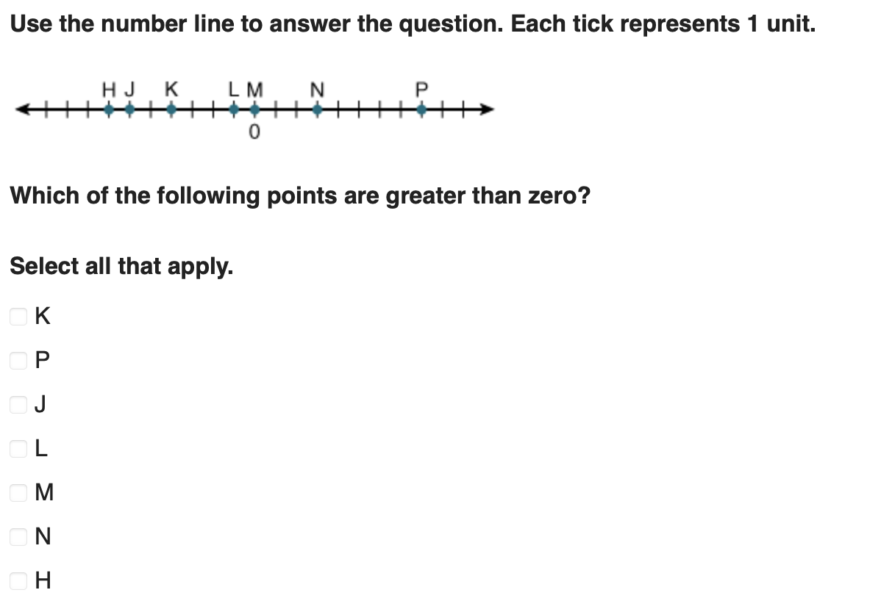
Lesson Quiz: Part III

Slide 25
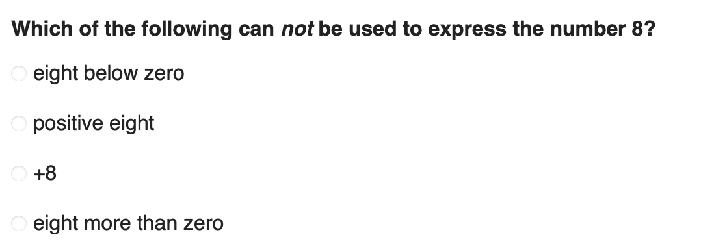
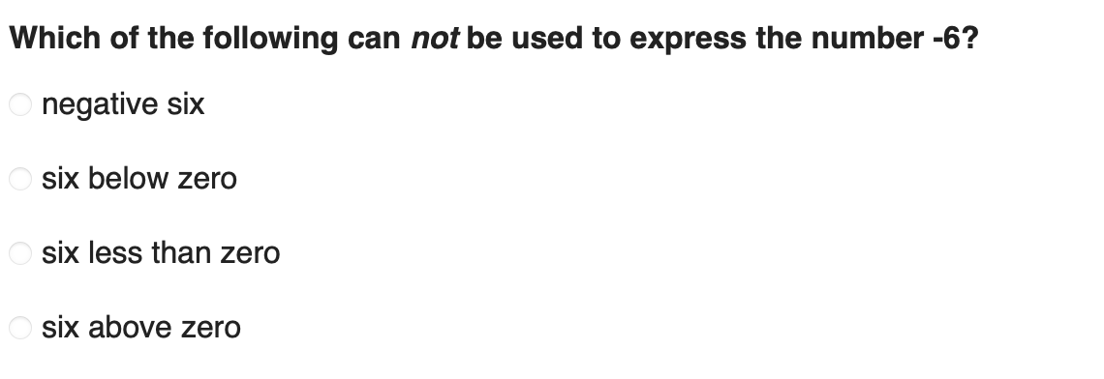
Lesson Quiz: Part IV

Slide 26
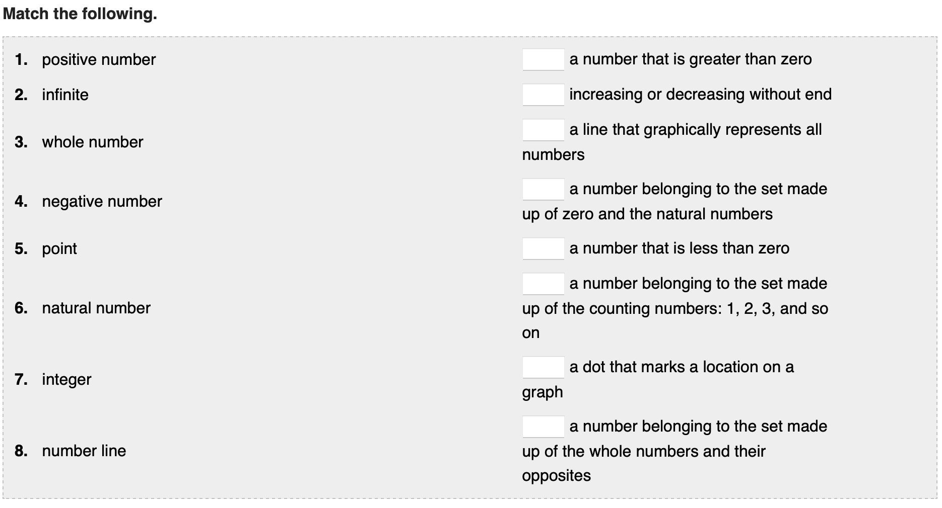
Lesson Quiz: Part V

